Slide 1

外商直接投资吸引力与基础设施数字化的发展潜力 FDI and Infrastructure Digitalization
September 2023

Slide 2
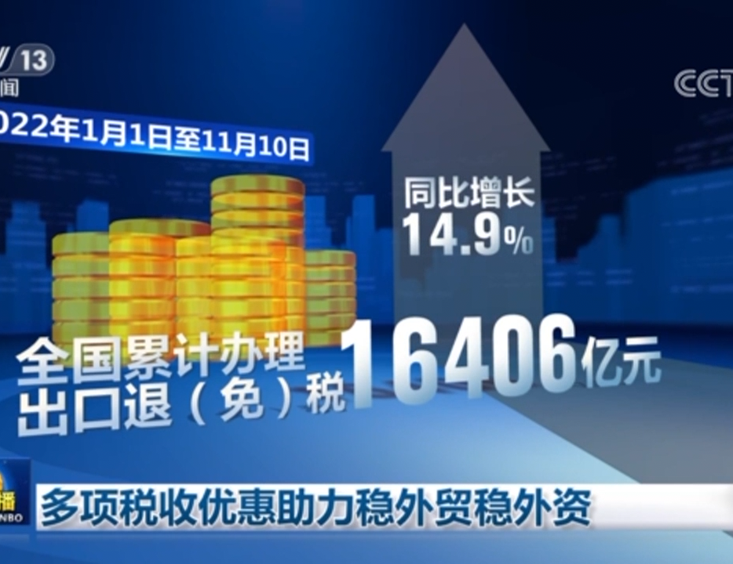
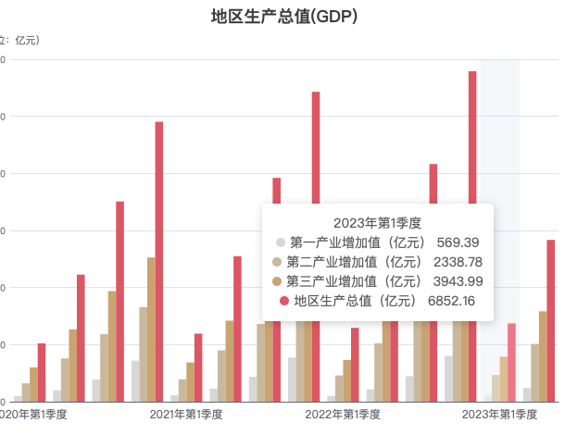
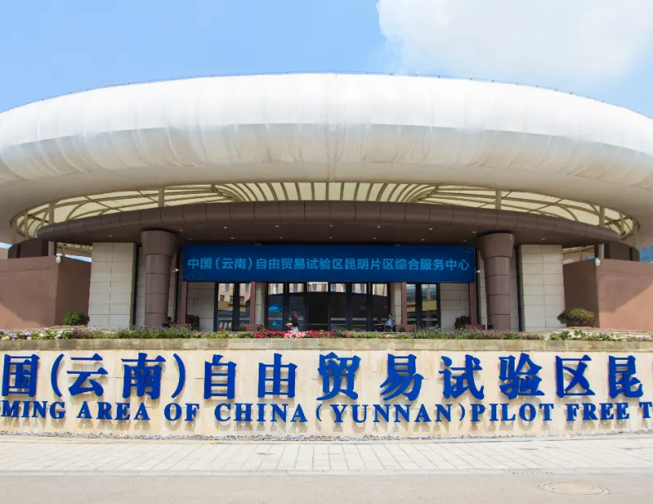
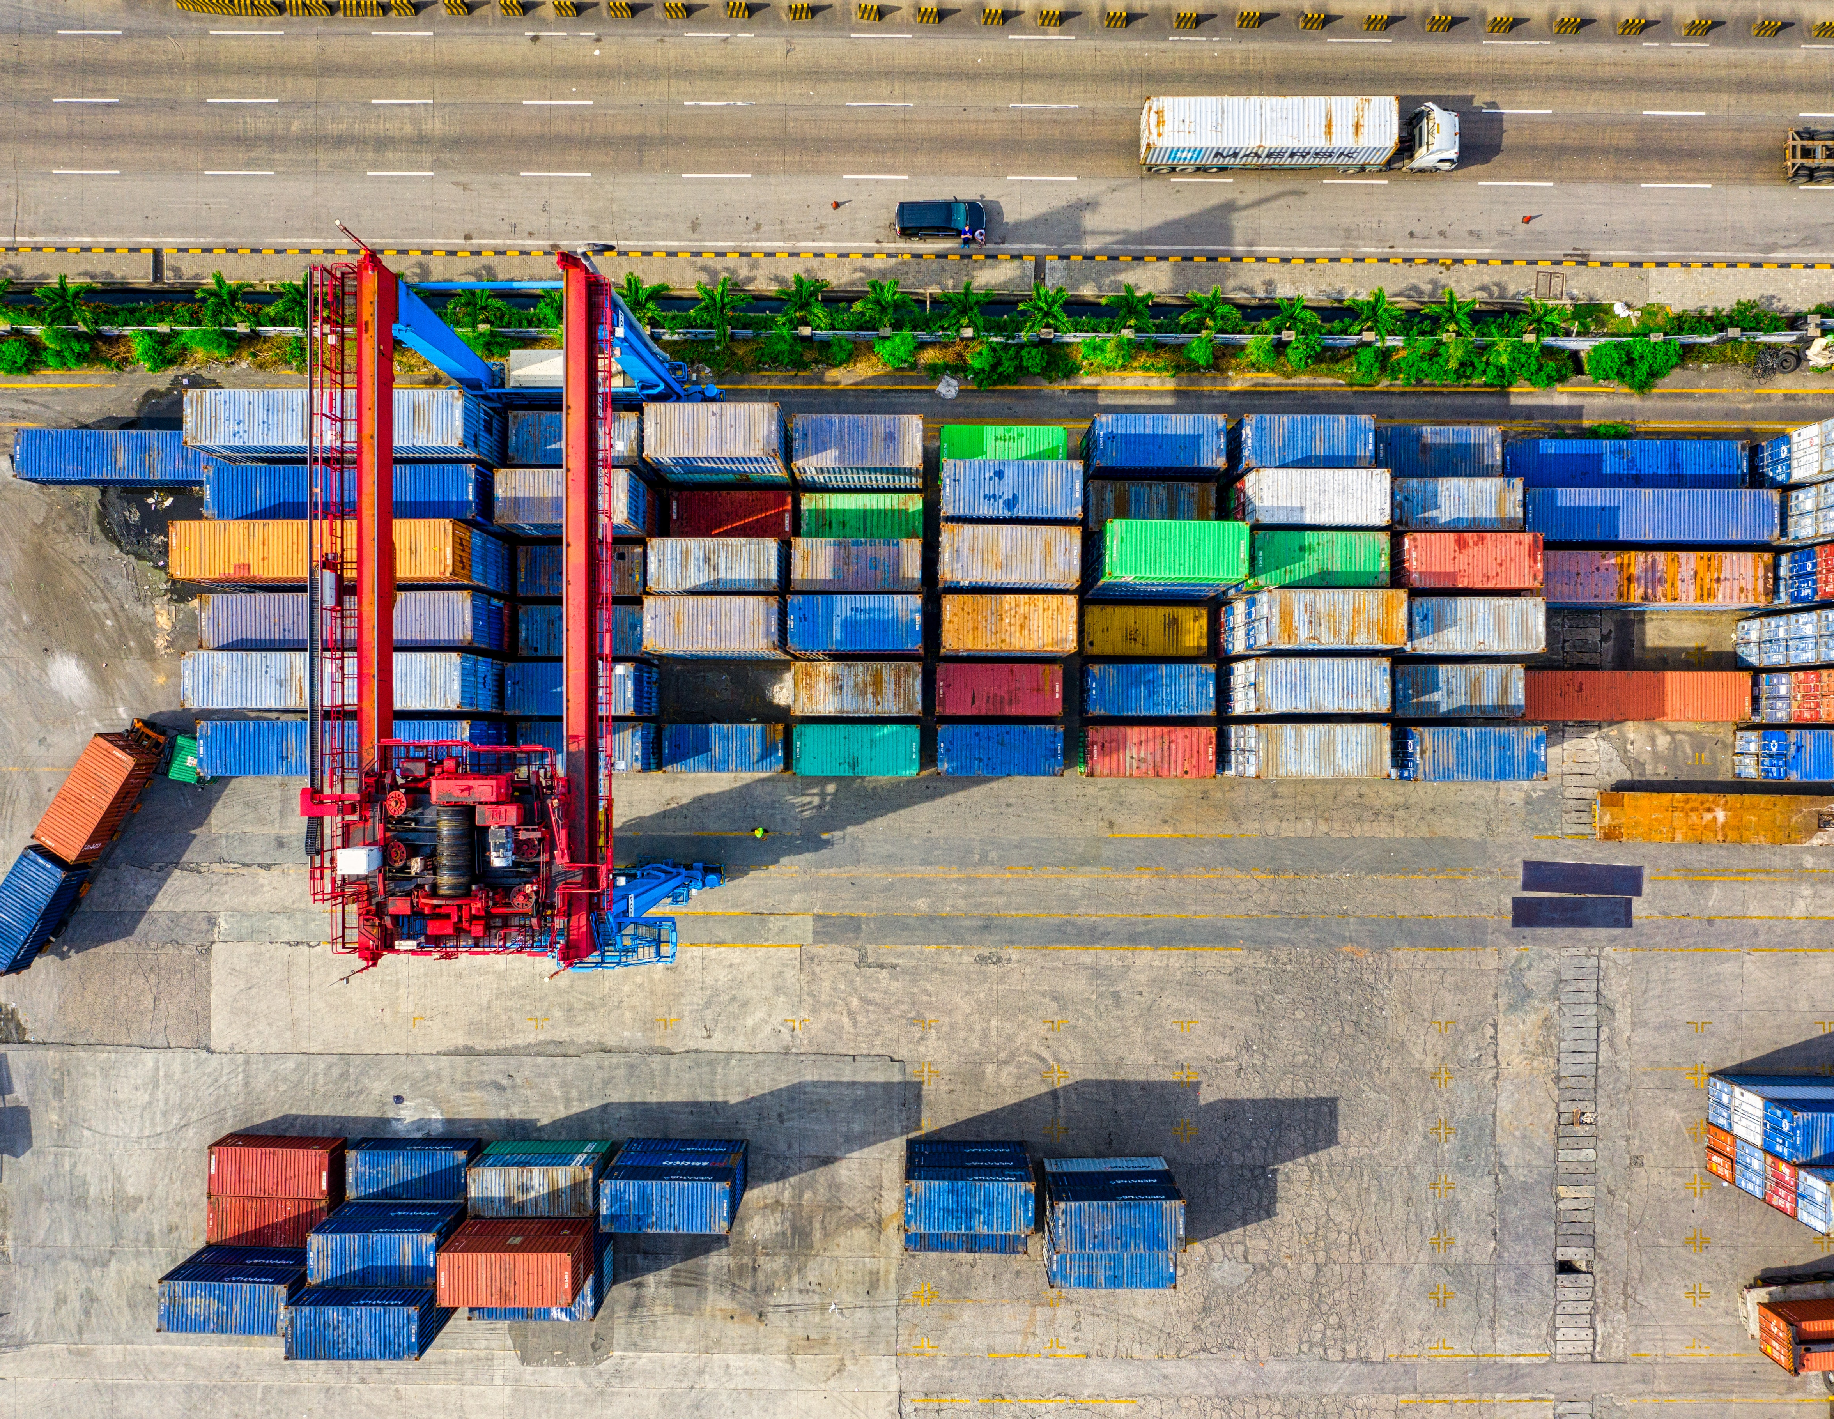
影响外商直接投资的重要指标
Key Factors That Affect FDI
政策稳定
Political Stability
当地市场规模
Size of Local Market
自由贸易区
Access to Free Trade Areas
运输与基础设施
Transport & Infrastructure
与政治稳定相关的是财政透明和相关机构的公信力，尤其是对司法系统以及法律和秩序的信任程度。
人口规模和经济增长潜力对吸引投资将至关重要。
参与自由贸易区的国家能够在保持其对贸易区外国家的现有贸易保护措施的同时享受关税免减。
影响投资吸引力的一个关键因素是交通成本和基础设施水平。
Notes:
1.Political stability
Foreign direct investment has an element of risk. Countries with an uncertain political situation, will be a major disincentive. Also, economic crisis can discourage investment. For example, the recent Russian economic crisis, combined with economic sanctions, will be a major factor to discourage foreign investment. This is one reason why former Communist countries in the East are keen to join the European Union. The EU is seen as a signal of political and economic stability, which encourages foreign investment.
Related to political stability is the level of corruption and trust in institutions, especially judiciary and the extent of law and order.
E.g. The state council announced a various opinions to further optimize the foreign investment environment and increase the attractiveness of foreign investment, which includes general requirements, enhancing the quality of foreign capital utilization, safeguarding national treatment for foreign-invested enterprises, continued strengthening of foreign investment protection, enhancing the level of investment and business operations convenience, intensifying financial and tax support, improving foreign investment promotion methods, strengthen organizational implementation.
2.Foreign direct investment is often targeted to selling goods directly to the country involved in attracting the investment. Therefore, the size of the population and scope for economic growth will be important for attracting investment. For example, Eastern European countries, with a large population, e.g. Poland offers scope for new markets. This may attract foreign car firms, e.g. Volkswagen, Fiat to invest and build factories in Poland to sell to the growing consumer class.
In the first half of the year, Yunnan achieved a regional GDP of 1,417.043 billion yuan, an increase of 5.1% year-on-year. The economic growth trend is basically consistent with the national level, with a 0.3 percentage point increase in growth rate compared to the first quarter. The economic operation has shown the characteristics of continuous economic recovery, strong and effective power supply, accelerated growth of new economic drivers, continuous adjustment and optimization of economic structure, and continuous improvement in people's livelihood security.
3.Access to a free trade area provides numerous benefits for FDI, including improved market access, cost reduction, regulatory harmonization, investment protection, and access to regional value chains. These factors collectively make FDI more attractive and contribute to economic growth and development within the FTA region.
4.A key factor in the desirability of investment are the transport costs and levels of infrastructure. A country may have low labour costs, but if there is then high transport costs to get the goods onto the world market, this is a drawback. Infrastructure plays a crucial role in attracting Foreign Direct Investment (FDI) and facilitating its success. A well-developed infrastructure can significantly enhance a country's competitiveness and make it an attractive destination for foreign investors.

Slide 3



基础设施数字化的发展潜力
Infrastructure Digitalization
数字平台能够提供的功能与便利：
税务流程数字化
Tax Infrastructure Digitalization
电子纳税申报
数字支付系统
数据分析报告
线上税务服务
各流程间的高度透明
商务流程数字化Commerce Infrastructure Digitalization
电子商务平台
数字支付
库存与供应链管理
客户关系管理系统(CRM)
数字营销
定价与销售策略的数据分析
运输管理数字化
Transport Infrastructure Digitalizaiotn
智能运输系统(ITS)
数字订单与支付
机队管理
线上流量管理软件
Notes:
1.Tax Infrastructure Digitalization:
Electronic Tax Filing: Implementing online tax filing systems allows individuals and businesses to submit their tax returns electronically. This streamlines the tax collection process, reduces paperwork, and minimizes errors.
Digital Payment Systems: Digital payment platforms and electronic invoicing can simplify the tax payment process, making it more convenient for taxpayers and reducing the risk of tax evasion.
Data Analytics: Tax authorities can use data analytics and artificial intelligence to identify tax fraud and evasion patterns, improving tax compliance and revenue collection.
Online Tax Services: Offering online tax services and information through government websites or mobile apps can provide taxpayers with easy access to tax-related information and services.
Blockchain for Transparency: Blockchain technology can be used to create transparent and tamper-proof tax records, reducing the potential for corruption and fraud.
2.Transport Infrastructure Digitalization:
Intelligent Transportation Systems (ITS): ITS technologies, including GPS, traffic sensors, and real-time data analysis, can enhance traffic management, reduce congestion, and improve transportation efficiency.
Digital Ticketing and Payments: Digital ticketing systems, such as contactless payment cards or mobile apps, make public transportation more convenient for passengers and reduce the need for physical tickets.
Fleet Management: Digitalization allows transportation companies to monitor and manage their vehicle fleets more effectively, optimizing routes, maintenance schedules, and fuel consumption.
Traffic Management Apps: Mobile apps that provide real-time traffic information and suggest alternative routes help commuters plan their journeys more efficiently.
3.Selling (Commerce) Infrastructure Digitalization:
E-Commerce Platforms: Online marketplaces and e-commerce websites enable businesses to reach a broader customer base and streamline the selling process.
Digital Payment Solutions: Secure digital payment options, such as credit card processing and digital wallets, enhance the convenience and security of online transactions.
Inventory and Supply Chain Management: Digital tools and software can help businesses optimize inventory levels, manage supply chains, and reduce overhead costs.
Customer Relationship Management (CRM) Systems: CRM systems enable businesses to better understand and serve their customers through data analysis and personalized marketing.
Data Analytics for Pricing and Product Strategies: Digitalization allows businesses to gather and analyze data to make informed decisions about pricing, product development, and marketing strategies.
Digital Marketing: Online advertising, social media marketing, and influencer partnerships are examples of digital marketing strategies that can help businesses reach their target audience effectively.

Slide 4



成功案例
Case Study
引进来
Introduce
扎下根
Develop
长成林
Incubate
数字化转型 Digital Transformation & Platform
Notes:
1.Tax Infrastructure Digitalization:
Electronic Tax Filing: Implementing online tax filing systems allows individuals and businesses to submit their tax returns electronically. This streamlines the tax collection process, reduces paperwork, and minimizes errors.
Digital Payment Systems: Digital payment platforms and electronic invoicing can simplify the tax payment process, making it more convenient for taxpayers and reducing the risk of tax evasion.
Data Analytics: Tax authorities can use data analytics and artificial intelligence to identify tax fraud and evasion patterns, improving tax compliance and revenue collection.
Online Tax Services: Offering online tax services and information through government websites or mobile apps can provide taxpayers with easy access to tax-related information and services.
Blockchain for Transparency: Blockchain technology can be used to create transparent and tamper-proof tax records, reducing the potential for corruption and fraud.
2.Transport Infrastructure Digitalization:
Intelligent Transportation Systems (ITS): ITS technologies, including GPS, traffic sensors, and real-time data analysis, can enhance traffic management, reduce congestion, and improve transportation efficiency.
Digital Ticketing and Payments: Digital ticketing systems, such as contactless payment cards or mobile apps, make public transportation more convenient for passengers and reduce the need for physical tickets.
Fleet Management: Digitalization allows transportation companies to monitor and manage their vehicle fleets more effectively, optimizing routes, maintenance schedules, and fuel consumption.
Traffic Management Apps: Mobile apps that provide real-time traffic information and suggest alternative routes help commuters plan their journeys more efficiently.
3.Selling (Commerce) Infrastructure Digitalization:
E-Commerce Platforms: Online marketplaces and e-commerce websites enable businesses to reach a broader customer base and streamline the selling process.
Digital Payment Solutions: Secure digital payment options, such as credit card processing and digital wallets, enhance the convenience and security of online transactions.
Inventory and Supply Chain Management: Digital tools and software can help businesses optimize inventory levels, manage supply chains, and reduce overhead costs.
Customer Relationship Management (CRM) Systems: CRM systems enable businesses to better understand and serve their customers through data analysis and personalized marketing.
Data Analytics for Pricing and Product Strategies: Digitalization allows businesses to gather and analyze data to make informed decisions about pricing, product development, and marketing strategies.
Digital Marketing: Online advertising, social media marketing, and influencer partnerships are examples of digital marketing strategies that can help businesses reach their target audience effectively.

